Slide 1

VISUALISING AND FORECASTING STOCKS USING DASH
By
2211CS050086 P. B .Akshaya
Under the Guidance of
Guide Name : Mrs. B. Swetha
Department of IOT
School of Engineering
Malla Reddy University
Hyderabad, Telangana, INDIA

Slide 2
ABSTRACT
The financial market is complex and ever-changing, making stock price prediction a challenging yet crucial task for investors. With advancements in machine learning (ML), it has become possible to develop models that can analyze historical data and provide forecasts with a reasonable degree of accuracy. This project aims to create an interactive Dash application that allows users to visualize stock price data and make forecasts using various machine learning algorithms. Stock investments provide one of the highest returns in the market. Even though they are volatile in nature, one can visualize share prices and other statistical factors which helps the keen investors carefully decide on which company they want to spend their earnings on. Developing this project idea using the Dash library (of Python), we can make dynamic plots of the financial data of a specific company by using the tabular data provided by yfinance python library. On top of it, we can use a machine learning algorithm to predict the upcoming stock prices.This application aims to provide users with an intuitive platform to analyze stock market data, experiment with different forecasting models, and make informed investment decisions.

Slide 3
1. Introduction
1.1 Problem Definition & Description:
Historical Data: Display historical stock price data in various chart formats (line charts, candlestick charts).
Technical Indicators: Include technical indicators like Moving Averages, Bollinger Bands, and Relative Strength Index (RSI).
Comparative Analysis: Allow users to compare multiple stocks or indices on the same chart.
Predictive Models: Implement machine learning models (e.g., ARIMA, LSTM, Prophet) to forecast future stock prices.
Model Evaluation: Show metrics like Mean Absolute Error (MAE) and Root Mean Squared Error (RMSE) for evaluating the accuracy of forecasts.
User Input: Allow users to select different stocks, date ranges, and forecasting models through interactive widgets.

Slide 4
Dynamic Updates: Update visualizations and forecasts in real-time based on user input.
Data Source Integration: Fetch historical stock data from APIs (e.g., Alpha Vantage, Yahoo Finance).
Data Processing: Clean and preprocess data for analysis and forecasting.
1.2 Objectives of the Project:
You will be creating a single-page web application using Dash (a python framework) and some machine learning models which will show company information (logo, registered name and description) and stock plots based on the stock code given by the user. Also the ML model will enable the user to get predicted stock prices for the date inputted by the user.
Implement and integrate machine learning models to predict future stock prices based on historical data. Utilize various forecasting models such as ARIMA, LSTM, and support vector regression modules to generate predictions. Provide users with the ability to choose different models and view forecast results along with confidence intervals.

Slide 5
1.3 Aim:
The aim of the project "Visualizing and Forecasting Stocks Using Dash and Machine Learning" is to develop a sophisticated web application that integrates interactive visualization with advanced predictive analytics to provide comprehensive insights into stock market trends. By leveraging Dash for dynamic, user-friendly data presentation and employing machine learning models for accurate forecasting, the project seeks to empower users with a robust tool for analyzing historical stock data and predicting future price movements.

Slide 6
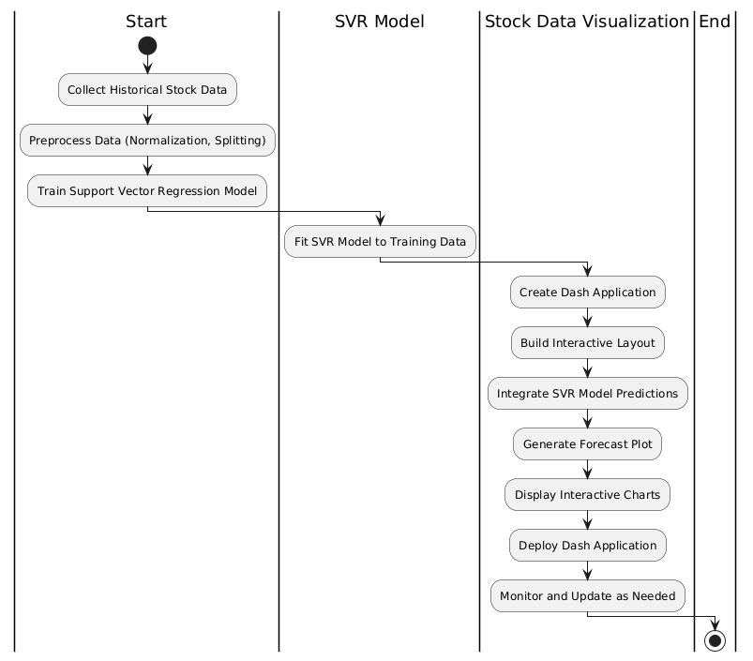
2. Methodology

Slide 7
Collect Historical Stock Data: Gather stock price data from a reliable source.
Preprocess Data: Normalize the data and split it into training and testing datasets.
Train SVR Model: Fit the Support Vector Regression model to the training data.
Create Dash Application: Set up a Dash app for visualization.
Build Interactive Layout: Design the layout of the app, including charts and controls.
Integrate SVR Model Predictions: Connect the SVR model to the Dash app for predictions.
Generate Forecast Plot: Create plots that show the forecasted stock prices.
Display Interactive Charts: Show interactive charts in the Dash app.
Deploy Dash Application: Deploy the app for users to access.
Monitor and Update: Continuously monitor the app and update as needed.

Slide 8
3. Technologies
1. Data Collection and APIs
Yahoo Finance: Provides historical stock data through its API.
Alpha Vantage: Offers real-time and historical data with various technical indicators.
Quandl: A platform for financial and economic data, including stock prices.
2. Data Processing and Preparation
Pandas: Essential for data manipulation and preprocessing, including handling missing values and feature engineering.
NumPy: Useful for numerical operations and array handling.
Scikit-learn: Provides tools for preprocessing data and creating training/testing datasets.
3. Machine Learning Models for Forecasting
ARIMA (AutoRegressive Integrated Moving Average): A classical time series forecasting model available in the statsmodels library.

Slide 9
4. Requirements
4.1 Software Requirements
Python: A modern version of Python (3.x) is essential for running most data science and web development libraries.
Data Collection and Processing:
Pandas: For data manipulation and analysis.
NumPy: For numerical operations and array handling.
Requests or yfinance: For fetching stock data from APIs.
Machine Learning:
Scikit-learn: For classical machine learning algorithms and preprocessing.
TensorFlow or PyTorch: For implementing and training deep learning models like LSTM.
Statsmodels: For statistical models such as ARIMA.

Slide 10
4.2 Hardware Requirements
Visualization and Dashboards:
Dash: For creating interactive web applications.
Plotly: For generating interactive and dynamic visualizations.
Matplotlib: Optional, for static plots if needed.
Development Machine: A standard modern computer with sufficient processing power and memory (e.g., 8GB RAM) for development and testing.
Server: For deployment, a server with adequate resources based on the expected traffic and computational needs (e.g., a cloud instance from AWS, Azure, or Google Cloud).

Slide 11
5. System Analysis
5.1 Literature Survey
1.Author: Zhang, Y., & Li, S.
Title: "Stock Price Forecasting Using Machine Learning: A Comparative Study"
Journal: Journal of Financial Data Science, 2021.
Summary: This paper explores various machine learning techniques, including Support Vector Regression (SVR), for stock price forecasting. It discusses the effectiveness of different models and provides insights into how these techniques can be integrated into visualization tools.
2.Author: Jones, M. A., & Brown, T. H.
Title: "Interactive Data Visualization for Financial Market Analysis: A Dash Application"
Journal: International Journal of Data Science and Analytics, 2022.
Summary: This paper presents a case study on developing an interactive data visualization application using Dash. It highlights how Dash can be utilized to create real-time stock market dashboards and integrates forecasting models, including SVR, to provide actionable insights.

Slide 12
5.2 Existing System
An existing system for visualizing and forecasting stocks using Dash typically involves an interactive web application built with Python's Dash framework. The system integrates financial data sources, such as Yahoo Finance or other APIs, to retrieve real-time and historical stock prices. Users can select different stocks, time frames, and indicators (like moving averages or RSI) through an intuitive user interface.
The system visualizes this data using interactive charts, often powered by Plotly, allowing users to zoom, hover, and filter the information dynamically. Additionally, forecasting models, such as ARIMA, LSTM, or other machine learning algorithms, are incorporated to predict future stock prices. These forecasts are presented alongside historical data, providing users with visual insights into potential trends.
5.3 Limitations of Existing System
Performance Bottlenecks: Dash applications, particularly those with complex visualizations and large datasets, can suffer from performance issues. As the amount of data or the number of concurrent users increases, the application might become slower, leading to a poor user experience.

Slide 13
Scalability Challenges: Scaling a Dash application for multiple users or large datasets can be challenging. Dash is typically not as scalable as other web technologies when it comes to handling high traffic or complex, real-time data updates.
Limited Built-In Machine Learning Tools: While Dash can integrate with machine learning models, it does not have built-in machine learning capabilities. Users must develop, train, and deploy these models separately, often requiring additional infrastructure and expertise.
Real-Time Data Limitations: Although Dash can visualize real-time data, the frequency and efficiency of real-time updates depend on the backend and data source. High-frequency trading or tick-by-tick data can overwhelm the system, making it difficult to maintain real-time accuracy.

Slide 14
5.4 Proposed System
1. Data Acquisition and Preprocessing
Data Sources: The system will fetch historical stock data from reliable financial data sources (e.g., Yahoo Finance, Alpha Vantage).
Preprocessing: The raw data will undergo preprocessing steps such as handling missing values, feature scaling, and transforming date-time features to make it suitable for SVR modeling.
2. Stock Visualization
Interactive Dashboard: Users can select different stocks and time frames through a user-friendly interface. The dashboard will visualize historical stock prices using interactive Plotly charts embedded in Dash.
Technical Indicators: Additional technical indicators like moving averages, Bollinger Bands, or RSI can be overlaid on the stock charts to provide more insights into market trends.

Slide 15
3. Support Vector Regression (SVR) for Forecasting
Model Training: The system will implement SVR, a powerful machine learning model, to predict future stock prices. The model will be trained on historical stock data, with features like previous closing prices, trading volume, and technical indicators.
Forecasting: Once trained, the SVR model will generate stock price forecasts for the selected time horizon. The forecasted data will be visualized alongside historical data to allow users to compare and interpret the predicted trends.
4. Model Evaluation
Mean Squared Error (MSE): The system will compute MSE to evaluate the average of the squared differences between the predicted and actual stock prices. This metric penalizes larger errors more heavily, providing a sense of the model's overall accuracy.
Mean Absolute Error (MAE): MAE will be used to measure the average magnitude of the errors in a set of predictions, without considering their direction. It gives a clear indication of the average prediction error in the same units as the stock prices.

Slide 16
Advantages of proposed system
1. Improved Prediction Accuracy
Support Vector Regression (SVR) is a robust machine learning technique that can handle non-linear relationships in stock data, leading to more accurate predictions compared to traditional linear models.
2. Comprehensive Model Evaluation
Utilizing Mean Squared Error (MSE) and Mean Absolute Error (MAE) allows for a thorough evaluation of the model’s performance, providing insights into both the average error and the impact of larger errors on forecasts.
3. Interactive and Customizable Visualization
The Dash framework offers an interactive, user-friendly interface, enabling users to customize their stock analysis experience by selecting different stocks, timeframes, and model parameters.
4. Real-Time Forecasting
The proposed system can integrate real-time data feeds, allowing for up-to-date stock forecasts that are crucial for making timely investment decisions.

Slide 17
Key Features of proposed system
1.Scalability and Accessibility
Deployed as a web application, making it accessible from any browser and scalable to handle multiple users and large datasets efficiently.
2.Secure Data Handling
Implements secure data transmission and storage practices to protect sensitive financial information and ensure user data privacy.
3.Enhanced User Control
Users can fine-tune SVR model parameters within the interface, providing them with control over the forecasting process and the ability to see how different configurations affect predictions.
4.User-Friendly Interface
Built with Dash, the application offers an intuitive interface that simplifies navigation and data interaction, making advanced forecasting accessible to users of varying expertise.

Slide 18
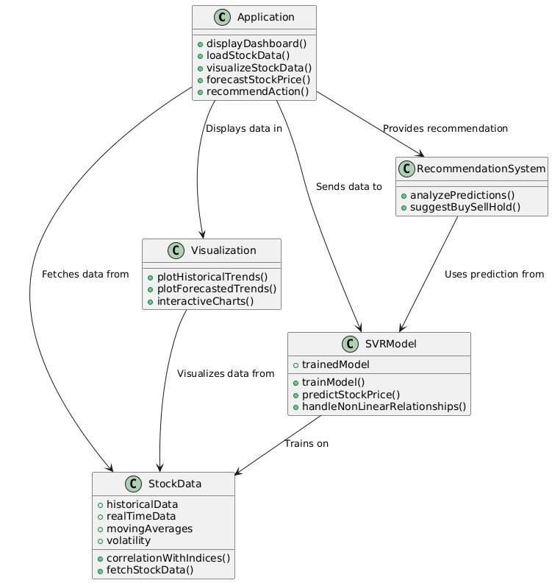
6.Project Architecture
6.6.1 Architecture Diagram
Application: This is the main component, which orchestrates everything. It calls methods to load stock data, forecast prices, visualize trends, and provide recommendations.
Stock Data: Responsible for fetching both historical and real-time stock data, and calculating metrics such as moving averages and volatility.
SVR Model: The Support Vector Regression model that is trained on the stock data and used to predict future stock prices.
Visualization: Handles the graphical representation of stock data, both historical and forecasted, using interactive charts.
Recommendation System: Analyzes the model's predictions and suggests buy, sell, or hold actions to the user.

Slide 19
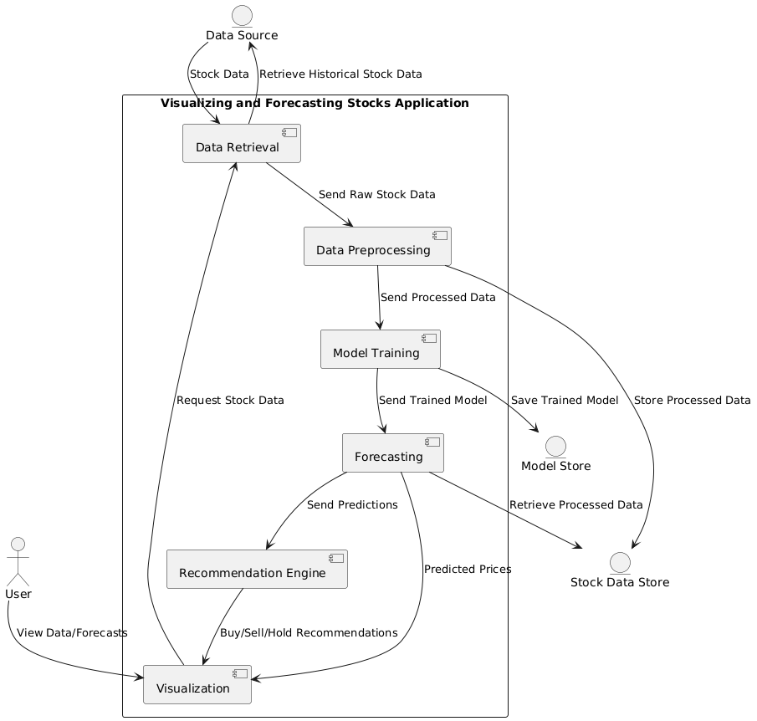
6.6.2 Data flow Diagram

Slide 20
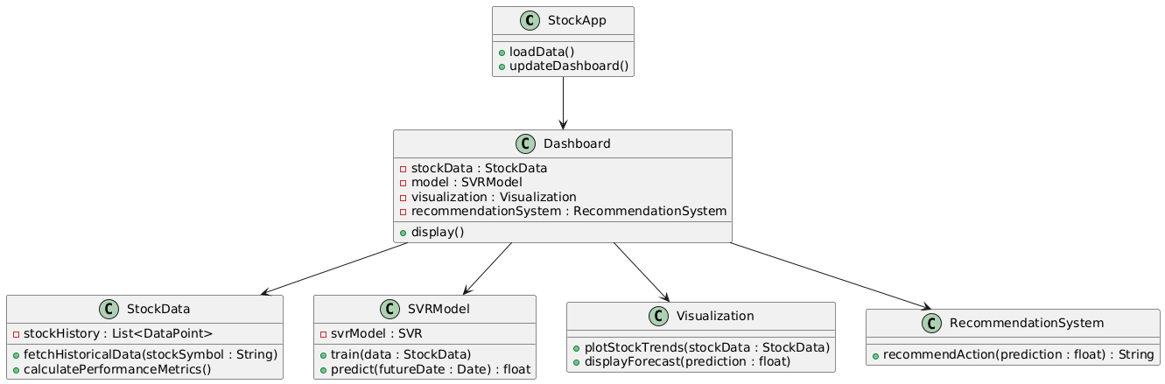
6.6.3 Class Diagram
Stock App: Main application class responsible for loading data and updating the dashboard.
Stock Data: Handles historical stock data, fetching and calculating performance metrics.
SVR Model: Represents the Support Vector Regression model, used to train on historical data and make predictions.
Visualization: Manages data visualization and forecast display.
Recommendation System: Suggests actions (buy, sell, hold) based on model predictions.
Dashboard: Core dashboard component that coordinates between stock data, model, visualization, and recommendation system for user interface display.

Slide 21
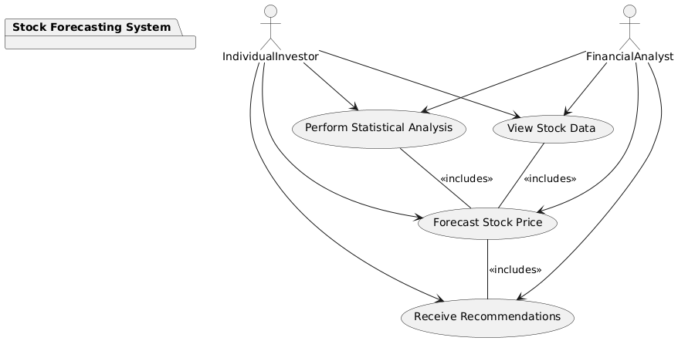
6.6.4 Use Case Diagram
View Historical Stock Data: Users can access historical stock data for analysis.
Visualize Stock Trends: Users can see graphical representations of stock performance over time.
Forecast Stock Prices: Users can generate future price predictions using the SVR model.
Receive Recommendations: Users receive buy, sell, or hold suggestions based on the forecast.
Perform Statistical Analysis: Users can analyze stock metrics such as moving averages, volatility, and correlations.
Interact with Dash Dashboard: Users engage with the interactive dashboard to select stocks, adjust parameters, and customize visualizations.

Slide 22
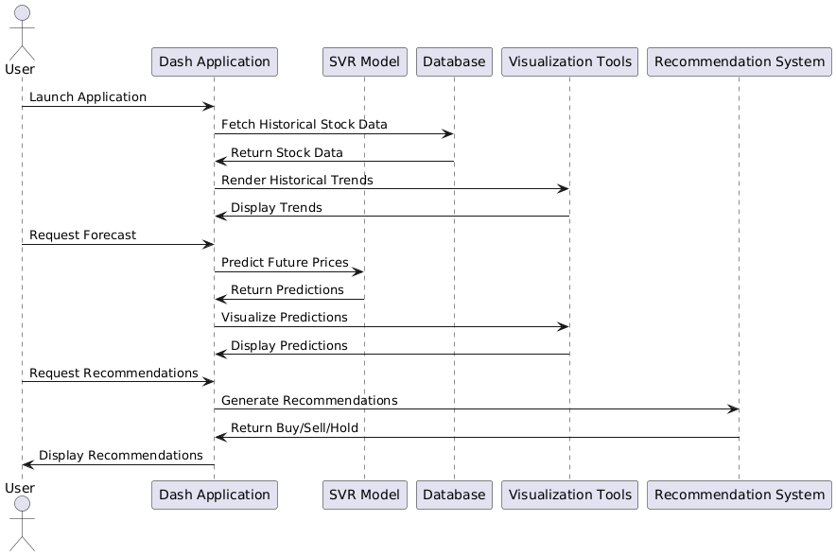
6.6.5 Sequence Diagram

Slide 23
Actors and Participants:
User: The individual interacting with the application.
Dash Application: The main application handling requests.
SVR Model: The machine learning model used for forecasting.
Database: Where historical stock data is stored.
Visualization Tools: Components responsible for rendering data visualizations.
Recommendation System: Generates buy/sell/hold recommendations based on predictions.
Interactions:
The user launches the application and requests stock data.
The application fetches historical stock data from the database and displays it using visualization tools.
The user can request forecasts, which the application gets from the SVR model.
Predictions are visualized and displayed back to the user.
Finally, the user requests recommendations, which the recommendation system provides based on the SVR's predictions.

Slide 24
Thank you

